Slide 1
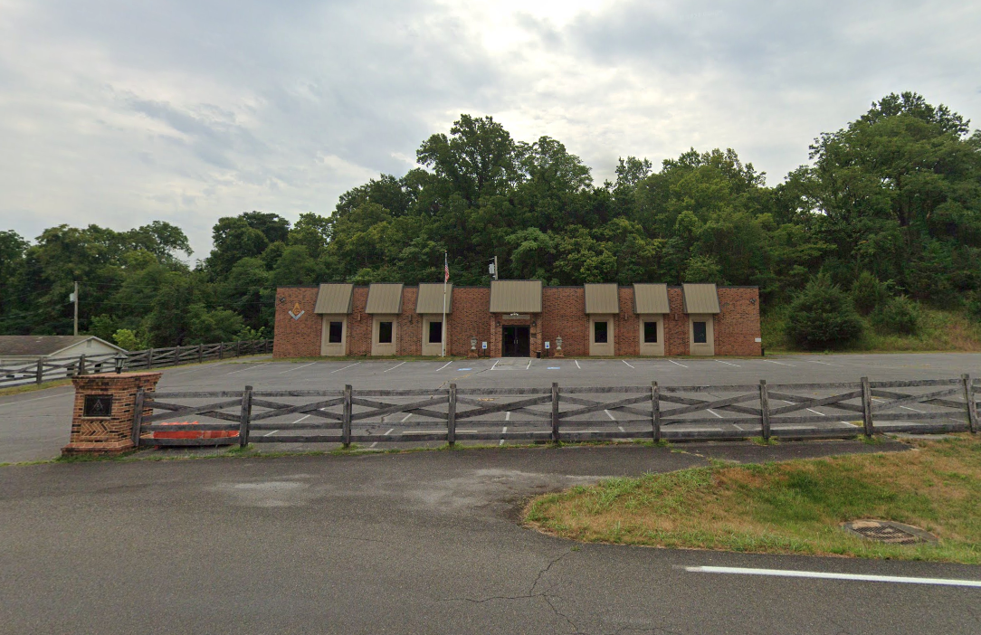
A History of
Unity Lodge No. 146
From Chester Lodge to the Present

Slide 2
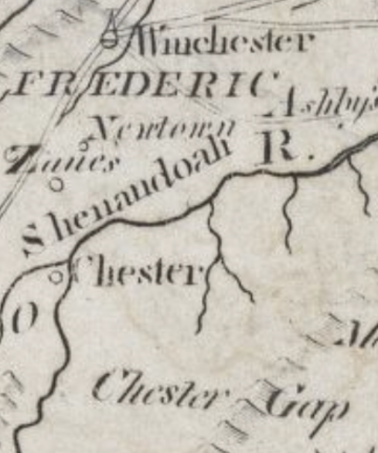
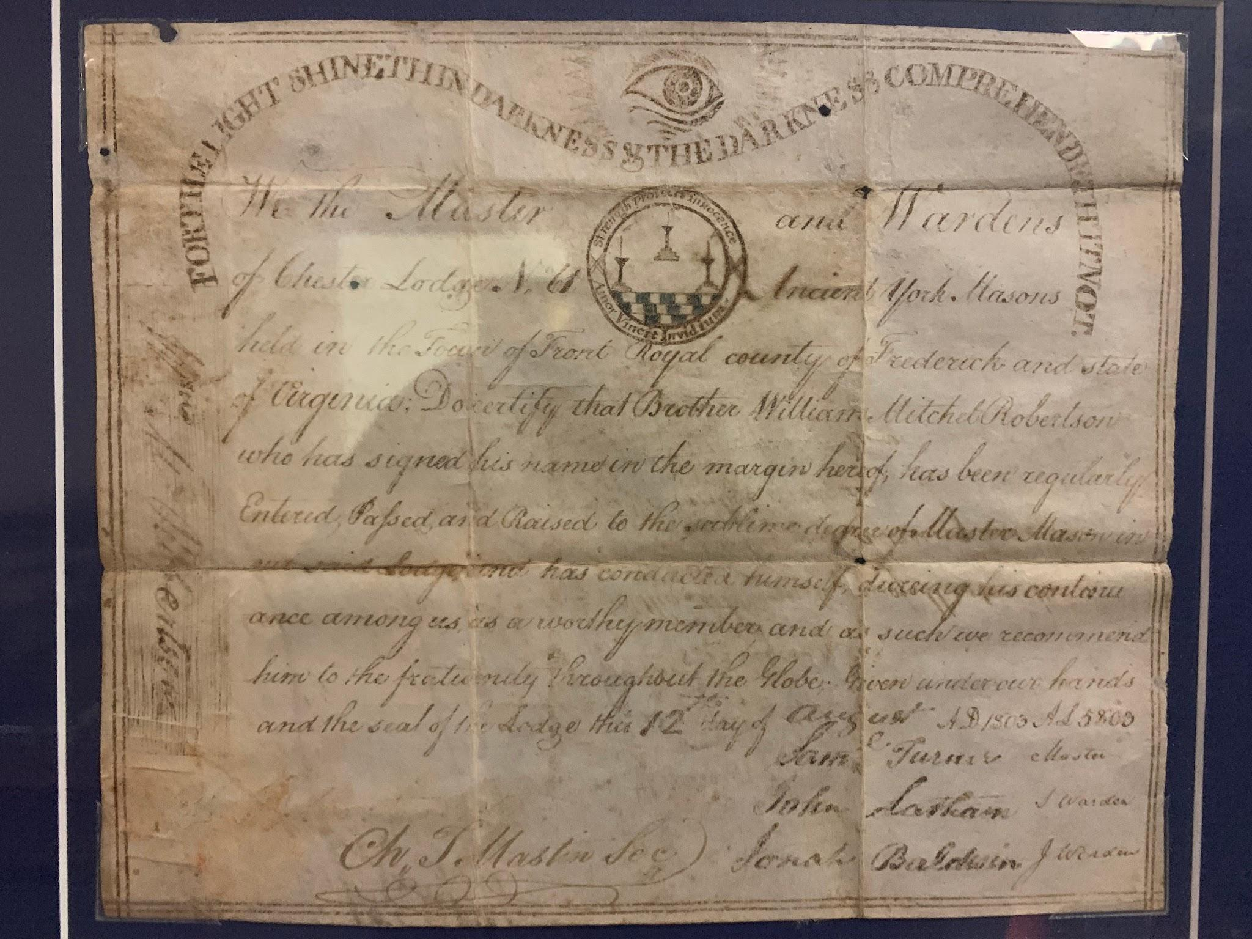
Chester Lodge No. 61
Chester Lodge No. 61
1799 to 1804
Between Chester Gap and Chester Ferry, along Chester Street within Front Royal
Front Royal established in 1788
Maps show Chester in 1794
Notes:
Chester MM certificate from 1803
Apron of William V. Henry Worshipful Master 1842-1844

Slide 3
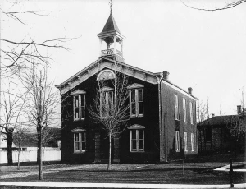
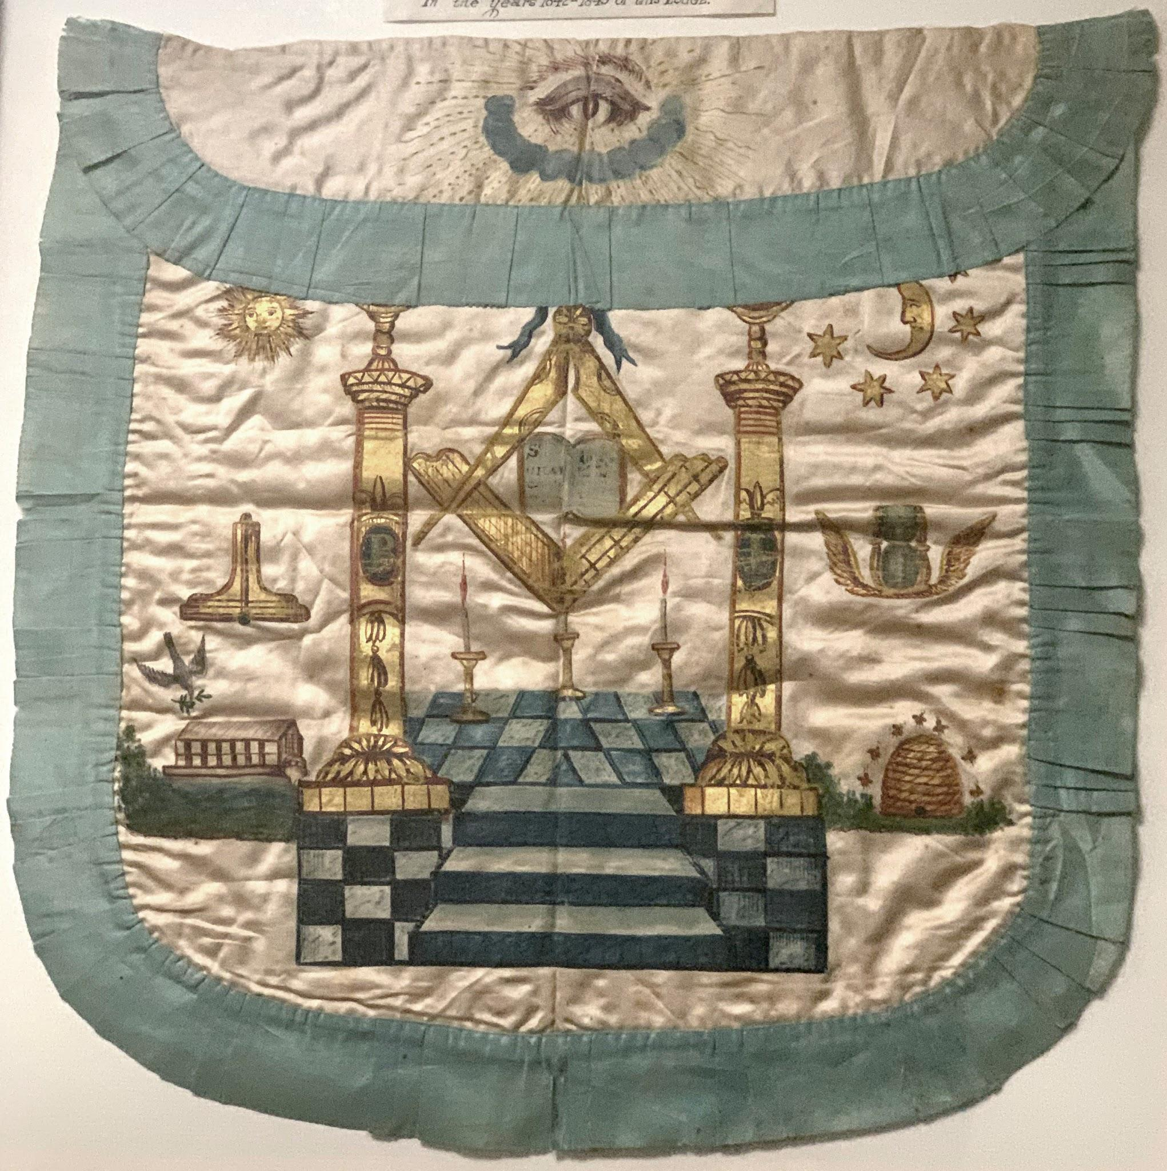
Front Royal Lodge No. 102
1816 to 1825
1840 to 1857
Winchester dedication: Hiram Hall 1822
Courthouse & Odd Fellows Hall

Slide 4
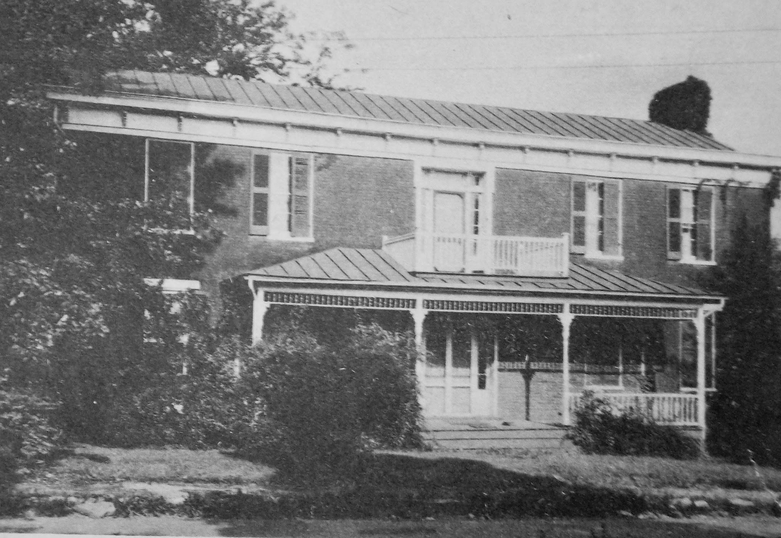
Founding of Unity
Chartered December 13, 1870
Old Front Royal Academy
Saturdays on/before full moon
17 applicants raised in the first year
15 MM became affiliated
Thomas N. Ashby as MM
Prominent figures in community
  Civil War veterans
  Business Men
  Lawyers
  Sheriff
  School Board
  Town Trustees

Slide 5
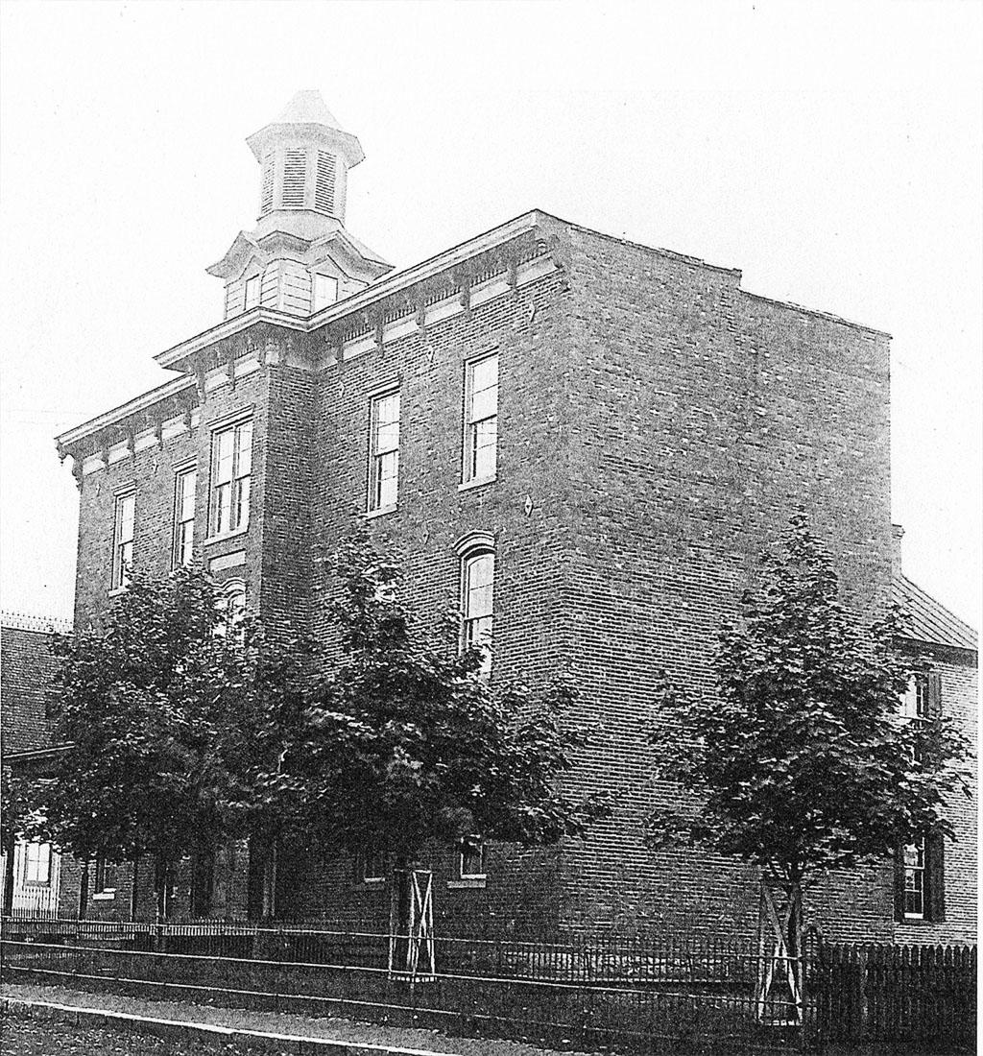
Public Free School Building: Union Hall
1876 Add third floor during construction
Rented to Secret Societies
  Independent Order of Odd Fellows
  International Order of Red Men
  Friends of Temperance
1892 added electricity
Notes:
Partnered with towns school trustees to

Slide 6
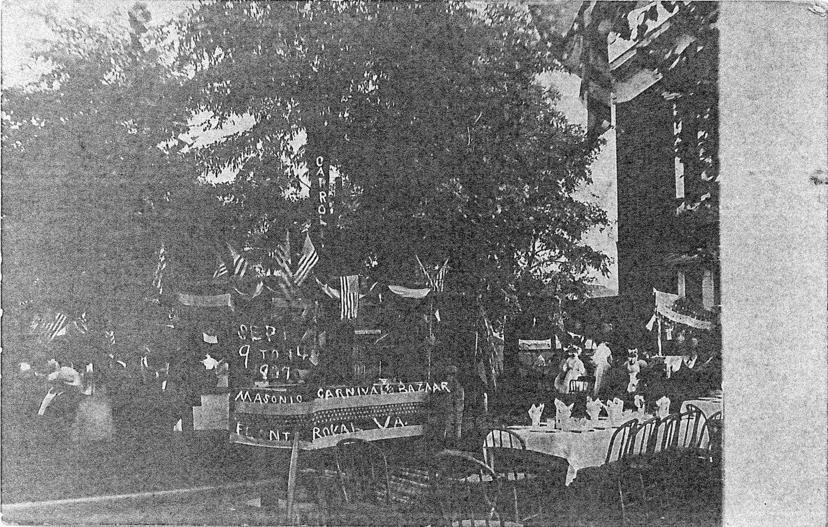
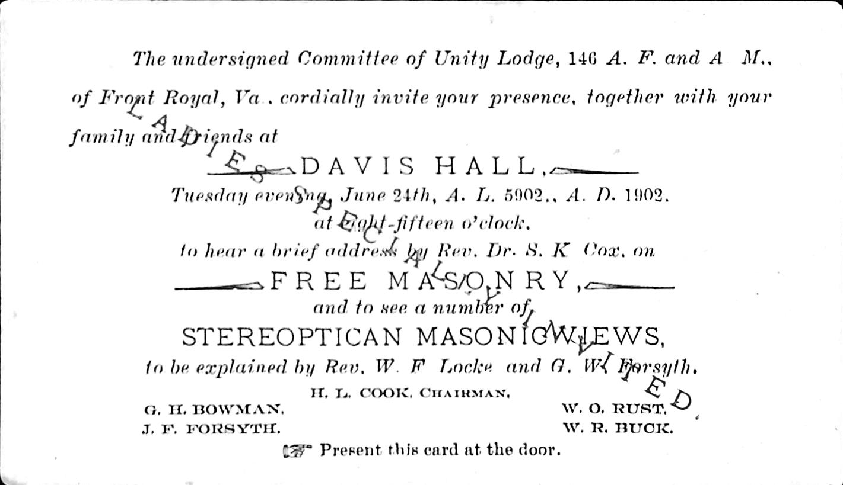
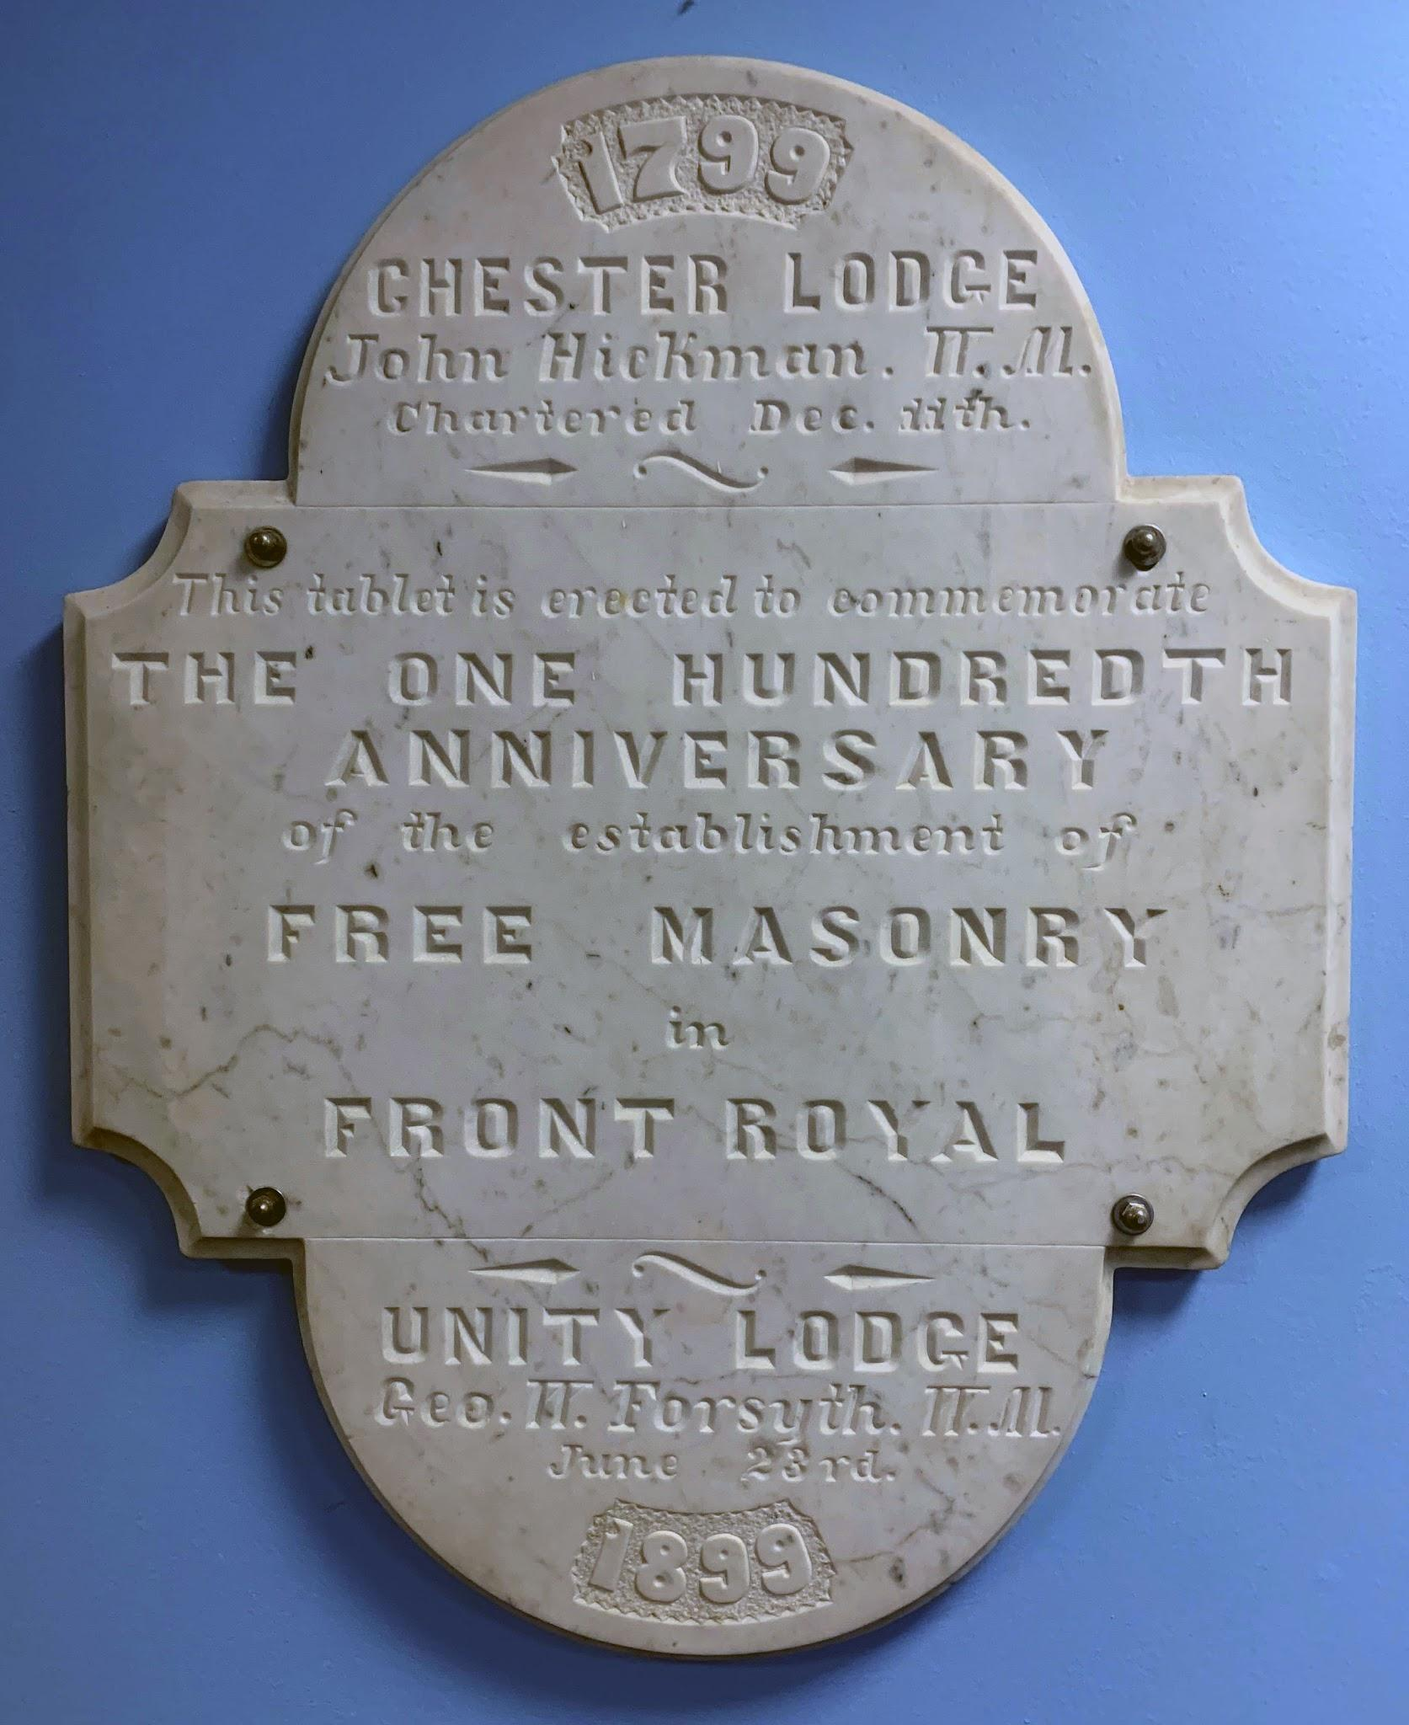
Events
1899: 100 Years in Front Royal
1902: Open House & Stereoptican
  At Davis Hall?
1904: Royal Arch Proposal
1907: Masonic Carnival & Bazaar

Slide 7
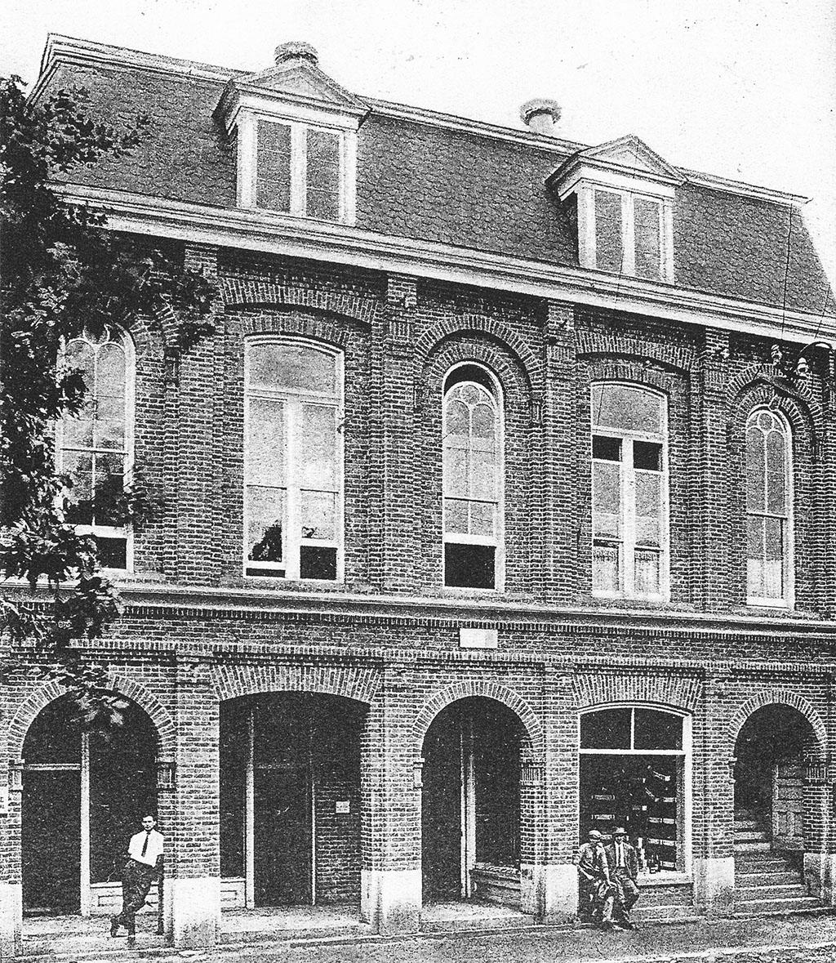
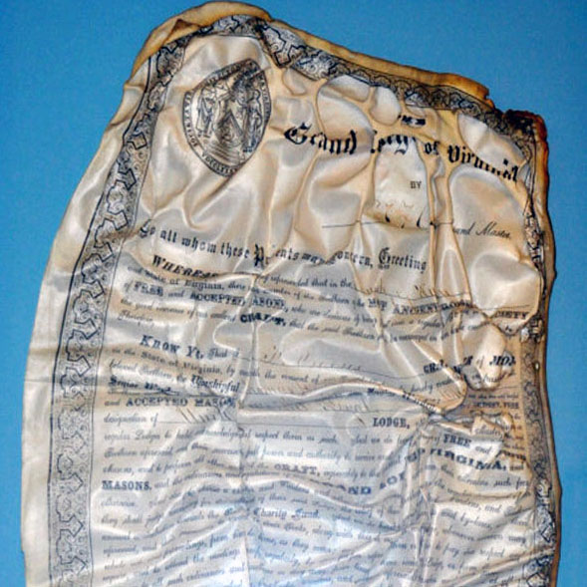
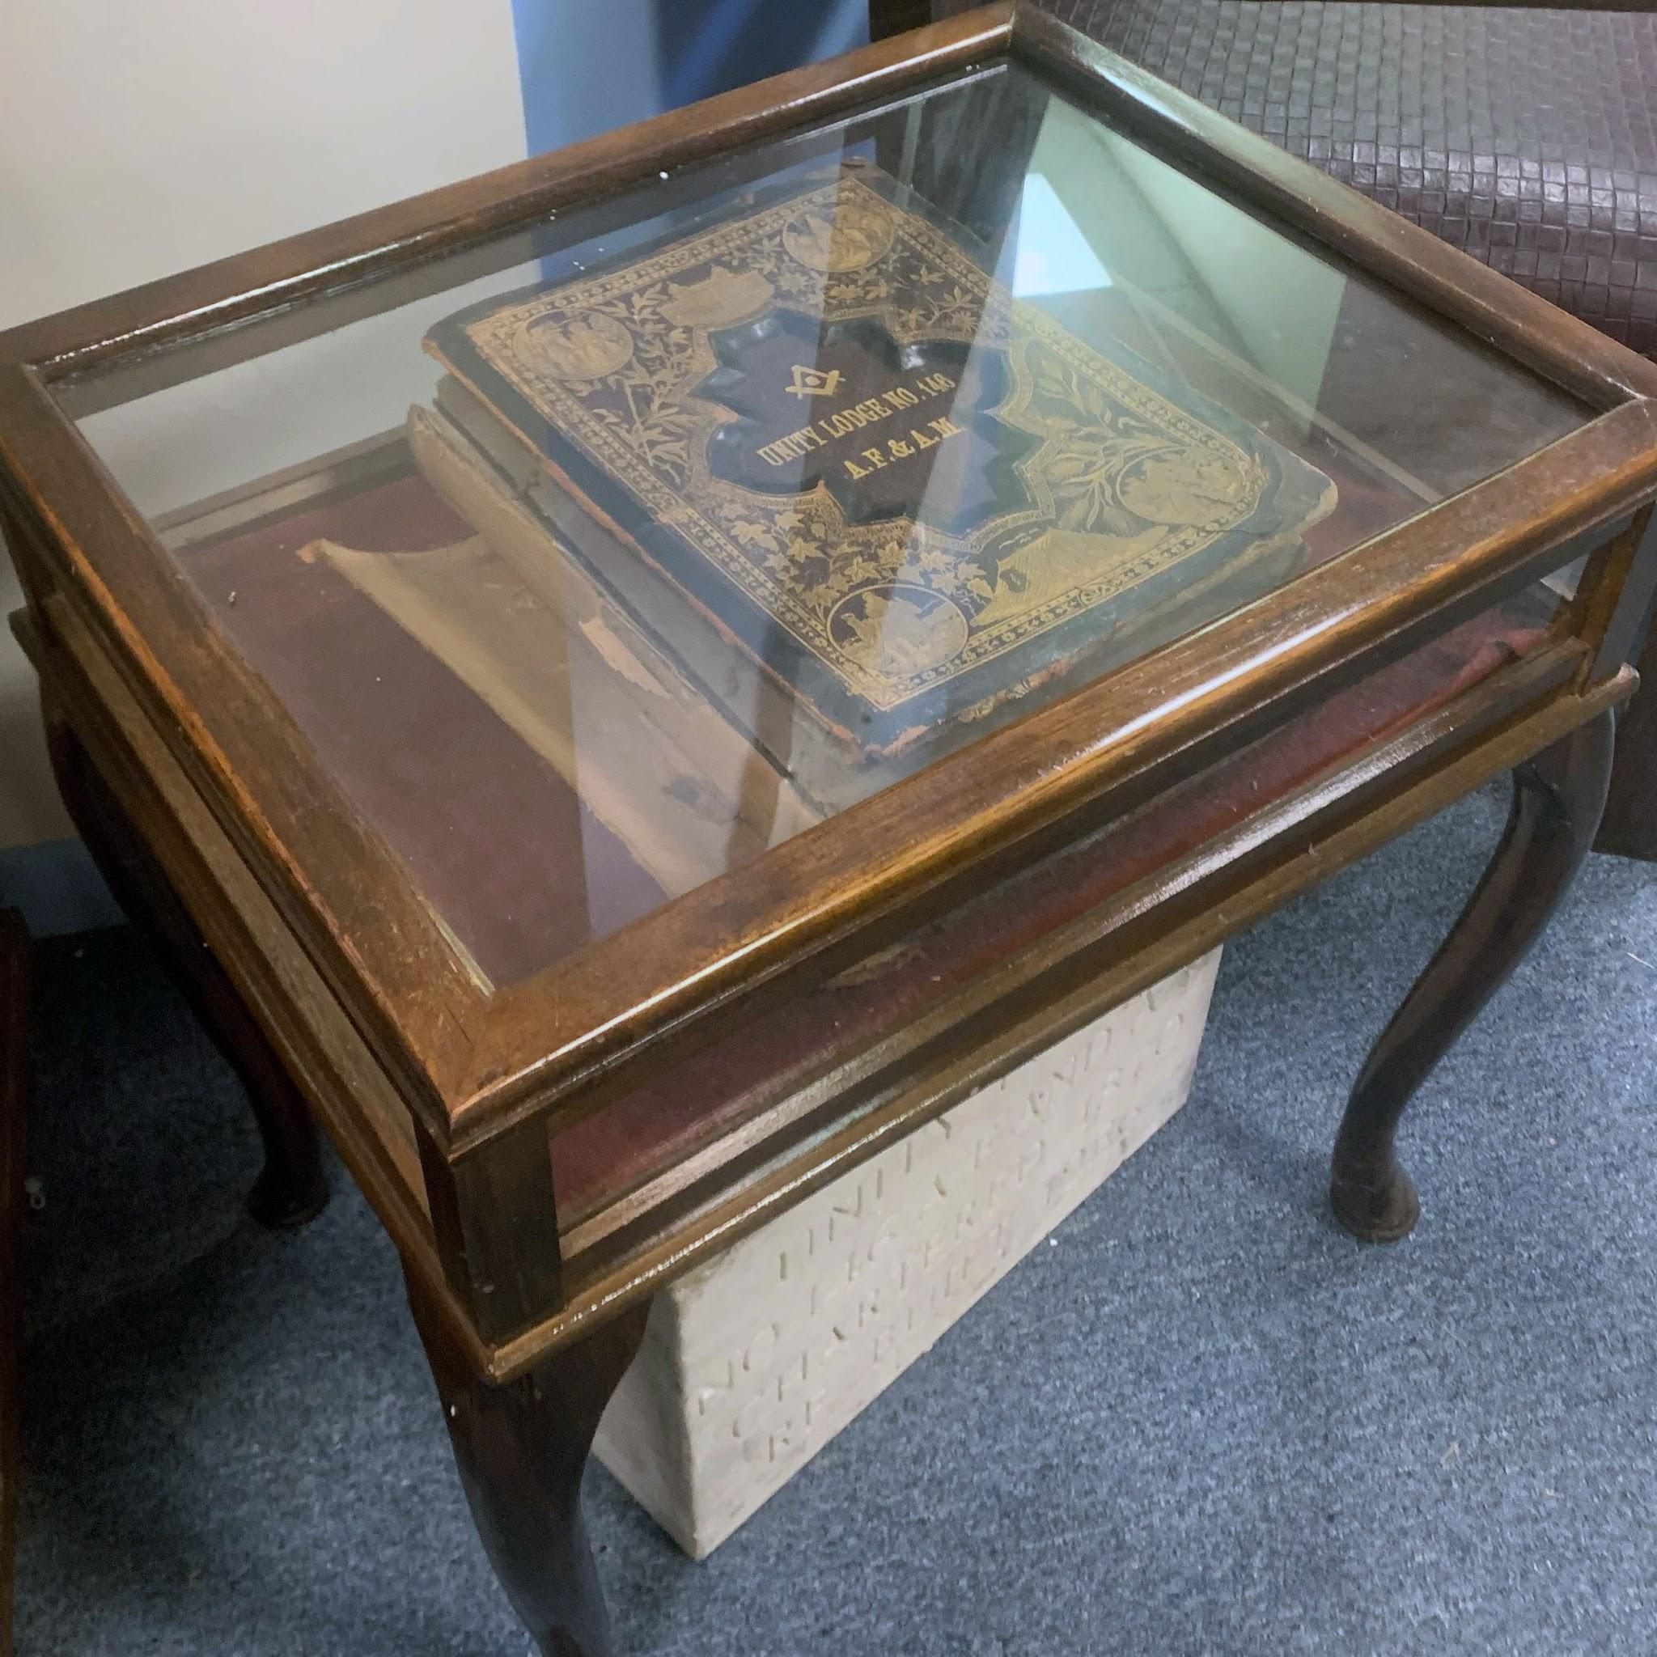
Murphy Building
1910
1914 Fire
  Odd Fellows provided a room during repairs
1916 Eastern Star Chartered
1918 Temple Property Search
1925 Search Renewed

Slide 8
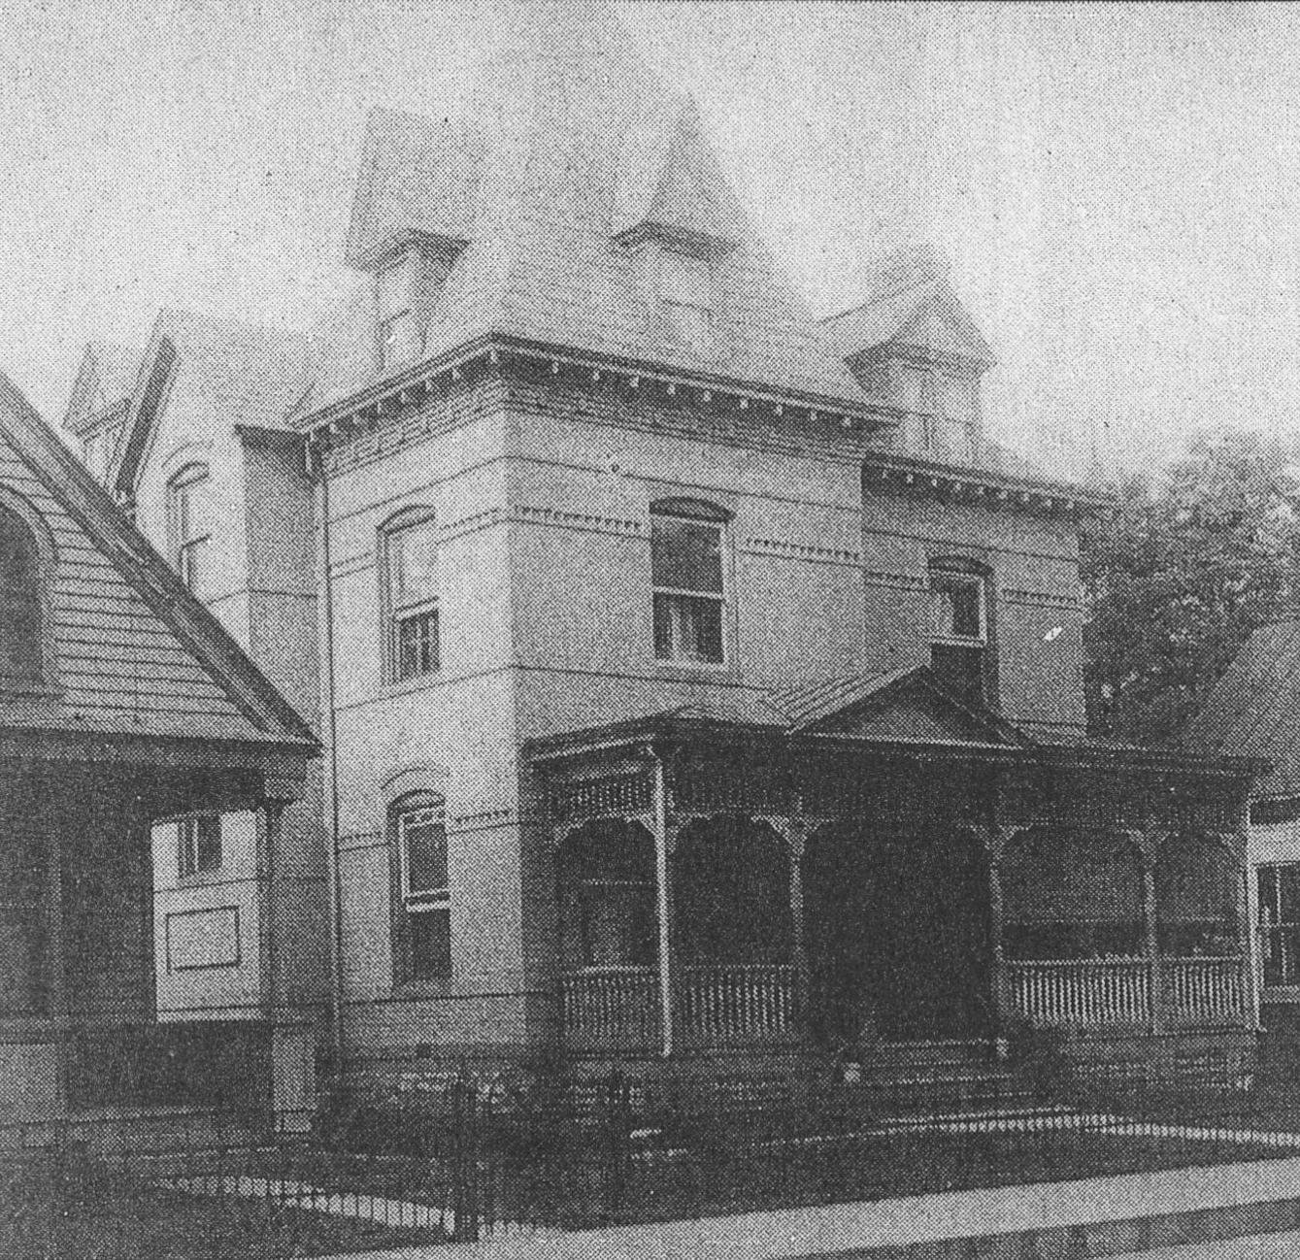
Dr. Hansbrough House: Masonic Hall
1926 Cornerstone
Government offices: Lawyers Row
1932 Restoration of Lodge History
1944 Two-Rivers DeMolay Chapter
1953 Temple Improvements
  Office & waiting room remodeled
  A/C installed
  3 bathrooms

Slide 9
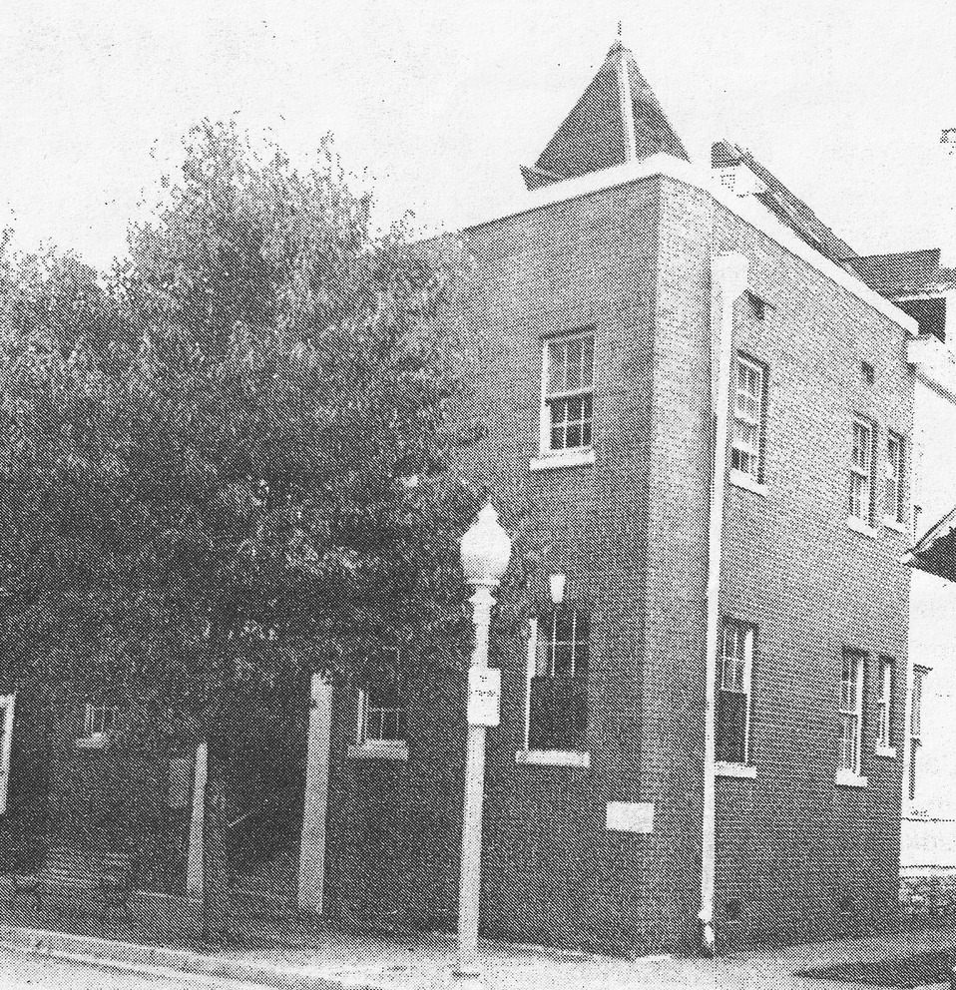
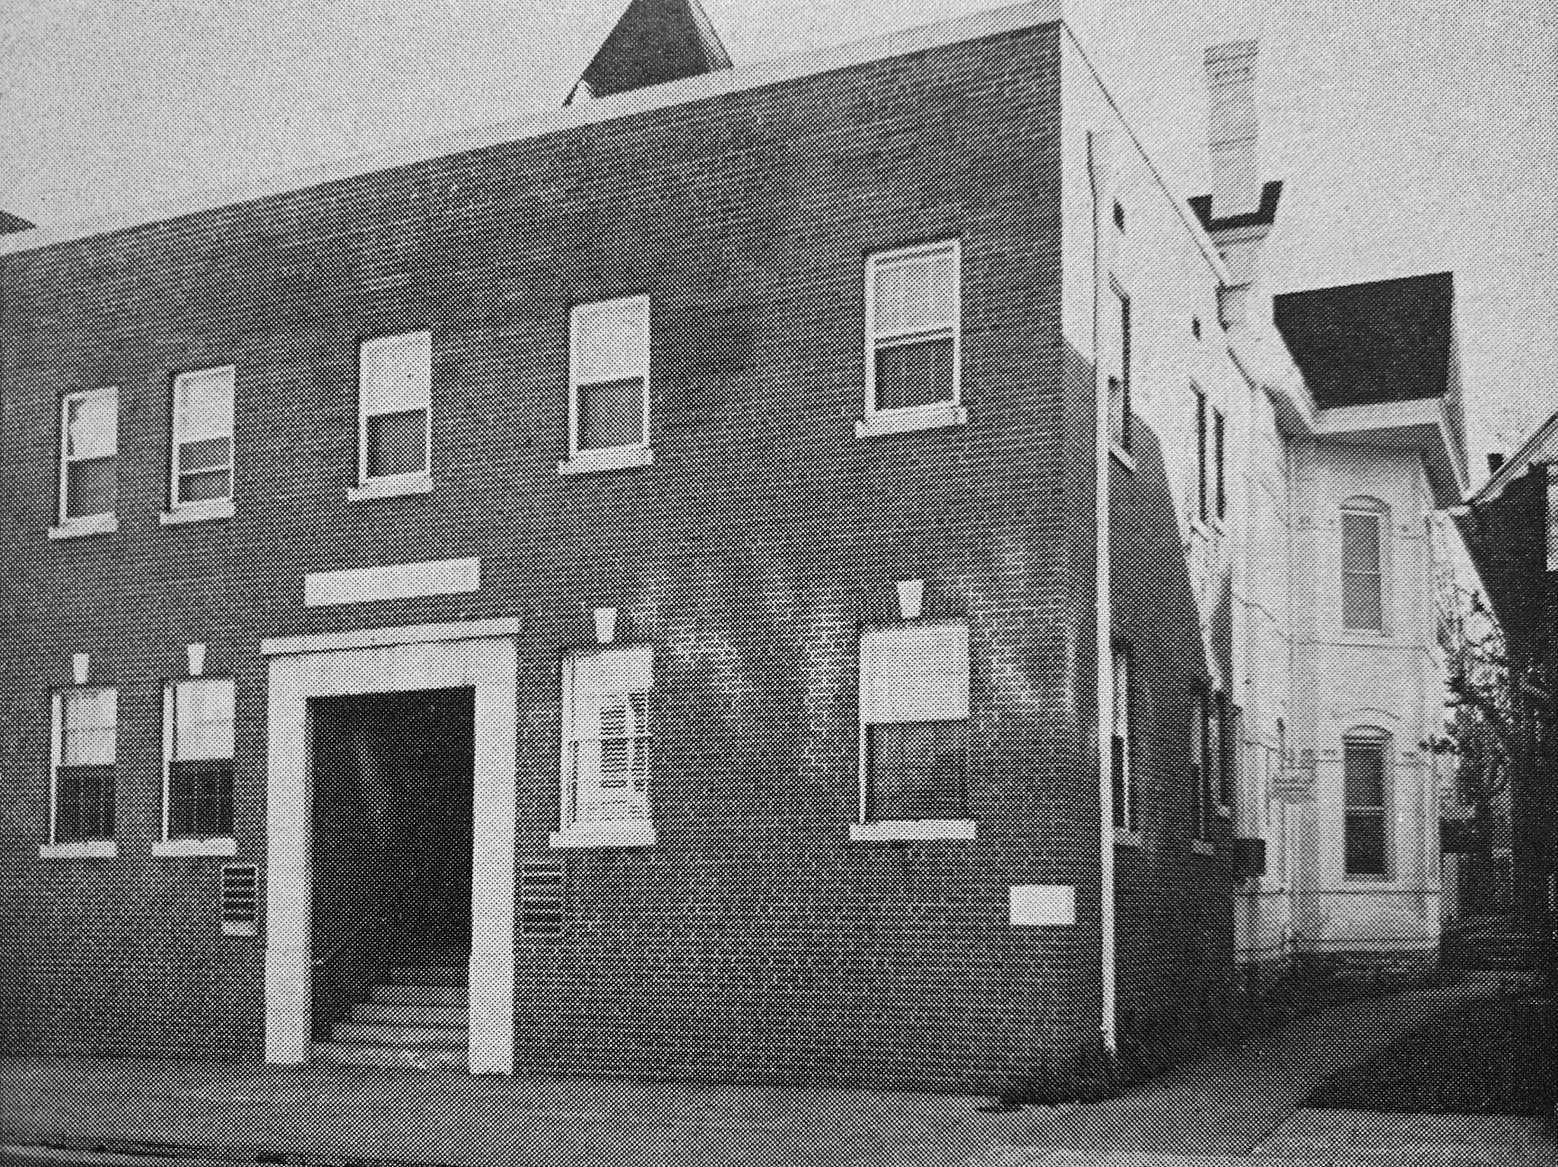
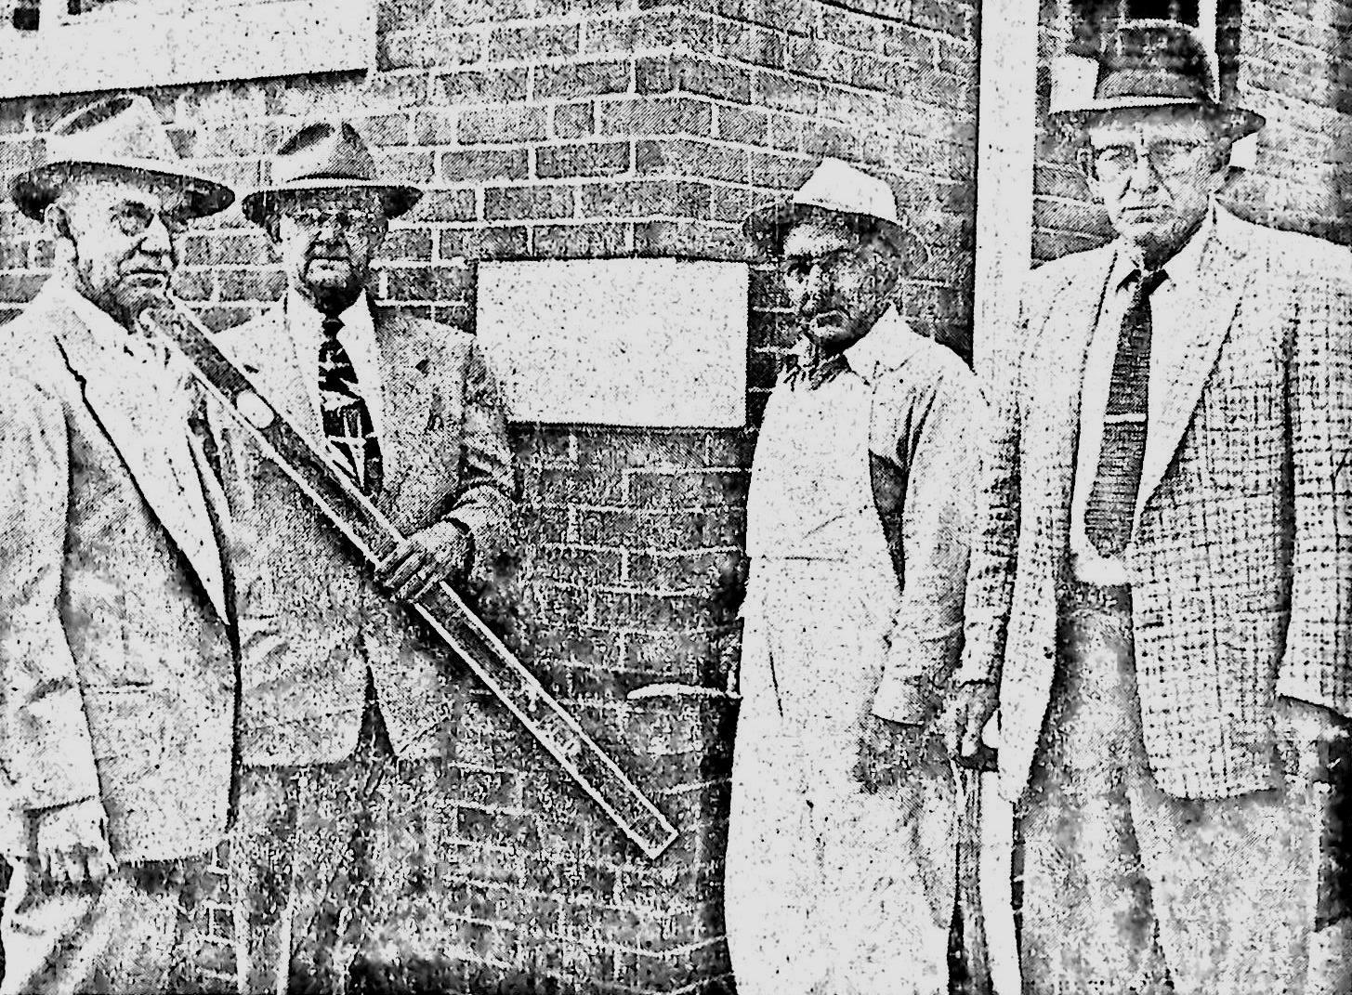
Modernization
1956 Modernization
1970 Unity 100th Anniversary
1997 Demolished

Slide 10
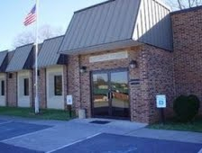
Second Masonic Temple
1988 Masonic Hall sold to county
  Lodge Purchased Criser Road
Efforts by:
  James Coverstone
  Ronald Bean
  Clyde Magee
  Bill Wood
Blueprints based on similar temples

Slide 11
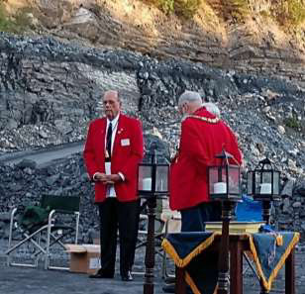
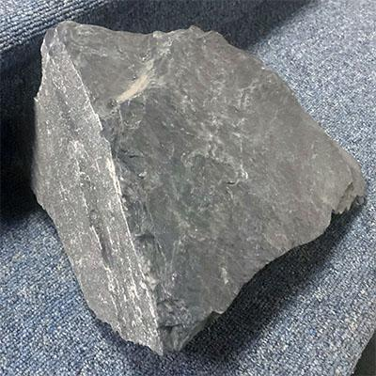
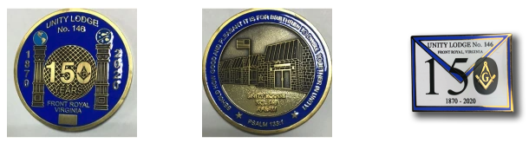
Events
2019 Unity 150th Anniversary
2019 Knights Templar Meetings at Unity
2019 Pandemic
2020 Leigh-Hanson Quarry Lodge
2021 Breakfast Returns
2023 Knights Templar Move/Rename
  Luray Commandery
  Jeffery Glen Burnham Commandery

